Slide 1
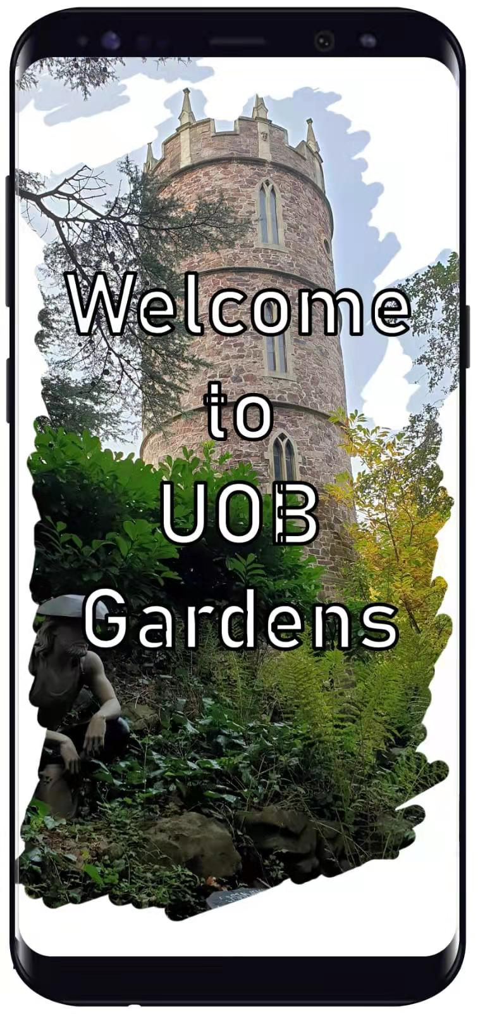

Slide 2

PLEASE

Slide 3


Slide 4
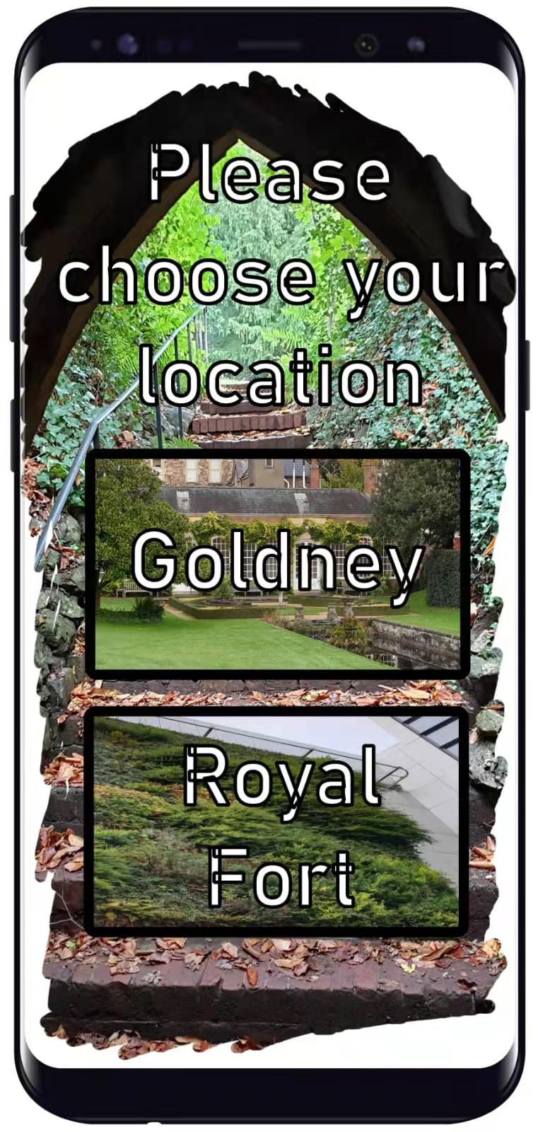

Slide 5
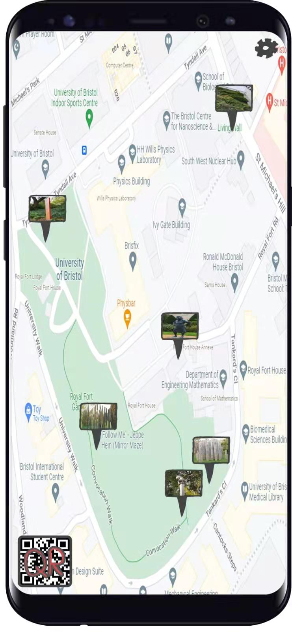

Slide 6
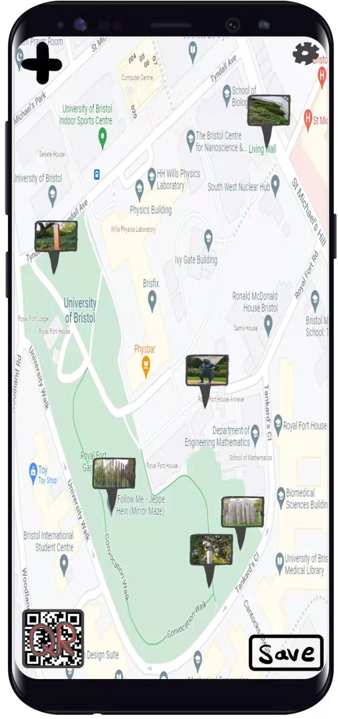

Slide 7

Settings
Dark Mode
GPS
OFF
OFF

Slide 8
Settings
Dark Mode
GPS
OFF
OFF

Slide 9

Settings
Dark Mode
GPS
ON
OFF

Slide 10
Settings
Dark Mode
GPS
ON
OFF

Slide 11
Settings
Dark Mode
GPS
OFF
OFF
Admin

Slide 12
Settings
Dark Mode
GPS
ON
OFF
Admin

Slide 13


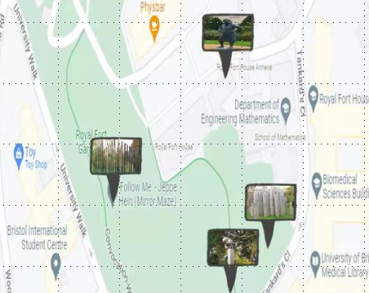



Admin
Link
Create QR

Slide 14
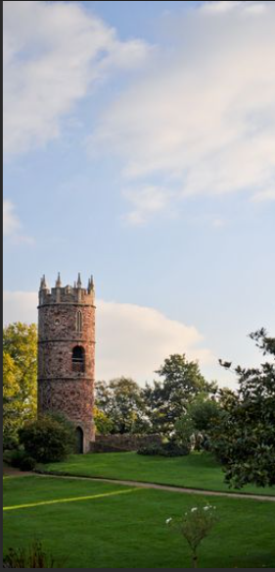


Thomas Goldney III enlarged and improved the grounds of Goldney Hall.
In 1724 the earlier house was partially demolished to be replaced by a grander building, possibly built by George Tully.

